Slide 1
project: CUSTOM MACHINE LEARNING LIBRARY VS SCIKIT-LEARN A Comparative Study of Custom Implementations vs Scikit-Learn
1
2
Project Guide : Ichchayakant Sharma
Department of Scientific Computing, Modeling and Simulation SPPU PUNE University
11 MARCH 2025
BHUSHAN SANJAY ZADE (MS2421)
VAISHNAV .C. MANKAR
(MS2409)

Slide 2
INTRODUCTION:
Custom Machine Learning Library Development: Implements Simple Linear Regression, Multiple Linear Regression, Decision Tree, Gradient Descent, Ridge, and Lasso Regression from scratch.
Objective: Compare custom implementations with Scikit-Learn in terms of performance, accuracy, and computational efficiency.
Key Analysis:
Evaluate Gradient Descent optimization techniques.
Built a decision tree from scratch, hard-coded its features, and fully grasped the intricacies of its formation and working.
Learning Outcome: Gain deeper insights into machine learning fundamentals.
Practical Relevance: Bridges the gap between theory and real-world application, enhancing model understanding and efficiency.
1
2
02

Slide 3
CUSTOM ML IMPLEMENTATION
01
1
2
3
03

Slide 4
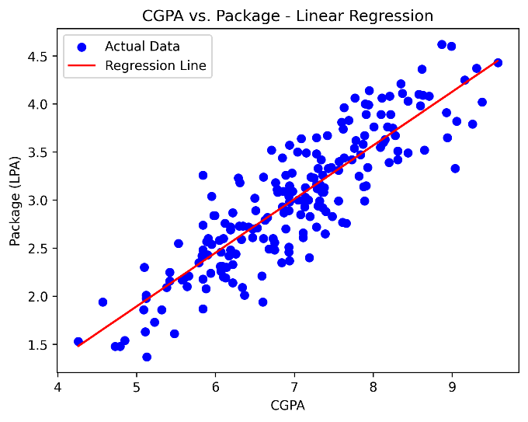
Simple Linear Regression
y=mx+c
1
SCIKIT LIBRARY ACCURACY
R2 SCORE : 0.780730147510384
MEAN ABSOLUTE ERROR : 0.2884710931878175
MEAN SQUARED ERROR : 0.12129235313495527
ROOT MEAN SQUARED ERROR : 0.34827051717731616
CUSTOM IMPLEMENTATION ACCURACY
R2 SCORE : 0.780730147510384
MEAN ABSOLUTE ERROR : 0.2884710931878175
MEAN SQUARED ERROR : 0.12129235313495527
ROOT MEAN SQUARED ERROR : 0.34827051717731616
2
04

Slide 5
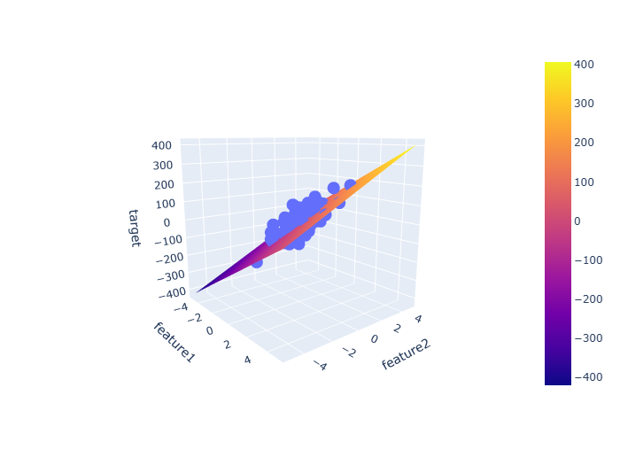
Multiple Linear Regression
y=b0​+b1​x1​+b2​x2​+⋯+bn​xn​
1
SCIKIT LIBRARY ACCURACY
R2 SCORE : 0.4399338661568968
MEAN ABSOLUTE ERROR : 45.21303419046903
MEAN SQUARED ERROR : 3094.4566715660626
ROOT MEAN SQUARED ERROR : 55.627840795469155
CUSTOM IMPLEMENTATION ACCURACY
R2 SCORE : 0.43993386615689756
MEAN ABSOLUTE ERROR : 45.213034190469
MEAN SQUARED ERROR : 3094.456671566058
ROOT MEAN SQUARED ERROR : 55.62784079546912
2
05

Slide 6
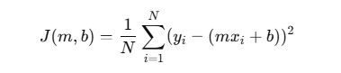
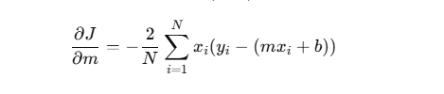
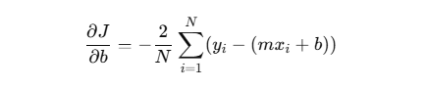
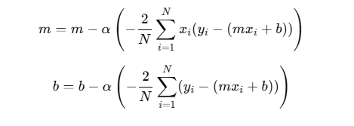
Gradient Descent
1
2
1
2
3
06

Slide 7
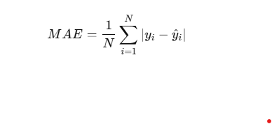
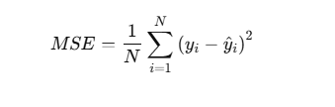

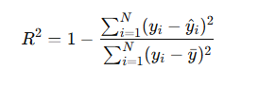
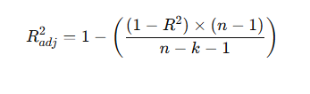
Performance Metrics (MAE,MSE,RMSE, R²,ADJUSTED R2)
1
2
3
4
5
07

Slide 8
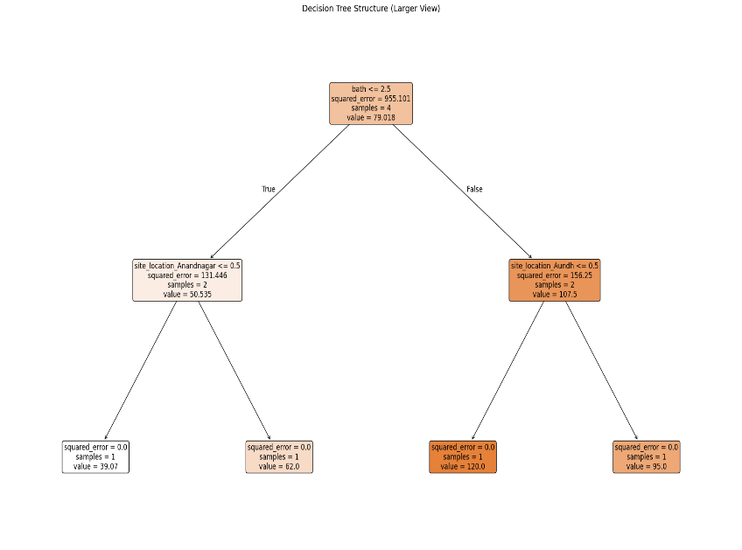
Decision Tree
1
SCIKIT LIBRARY ACCURACY
R2 SCORE : 0.4756986562313
MEAN ABSOLUTE ERROR : 39.9123564891
MEAN SQUARED ERROR : 9353.43124546
ROOT MEAN SQUARED ERROR : 97.20953075355716
CUSTOM IMPLEMENTATION ACCURACY
R2 SCORE : 0.459859615288256
MEAN ABSOLUTE ERROR : 40.10281389484881
MEAN SQUARED ERROR : 9449.692869326776
ROOT MEAN SQUARED ERROR : 97.20953075355716
2
08

Slide 9


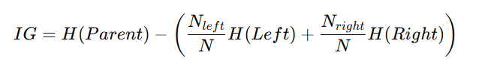

Formula Used In Decision Tree
1
2
1
2
3
09

Slide 10
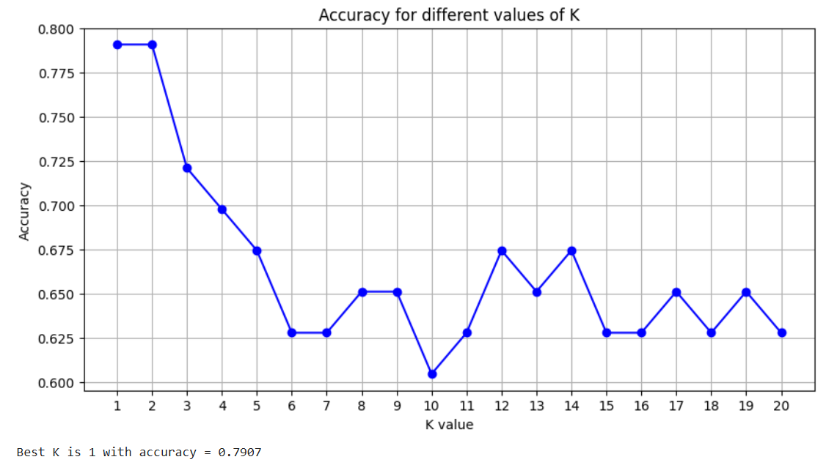
K Nearest Neighbore
SCIKIT LIBRARY ACCURACY
WITH K = 3
ACCURACY : 0.9649
1
CUSTOM IMPLEMENTATION ACCURACY
WITH K = 3
ACCURACY : 0.9649
SCIKIT LIBRARY ACCURACY
WITH K = 1
ACCURACY : 0.7907
CUSTOM IMPLEMENTATION ACCURACY
WITH K = 1
ACCURACY : 0.7907
2
10

Slide 11
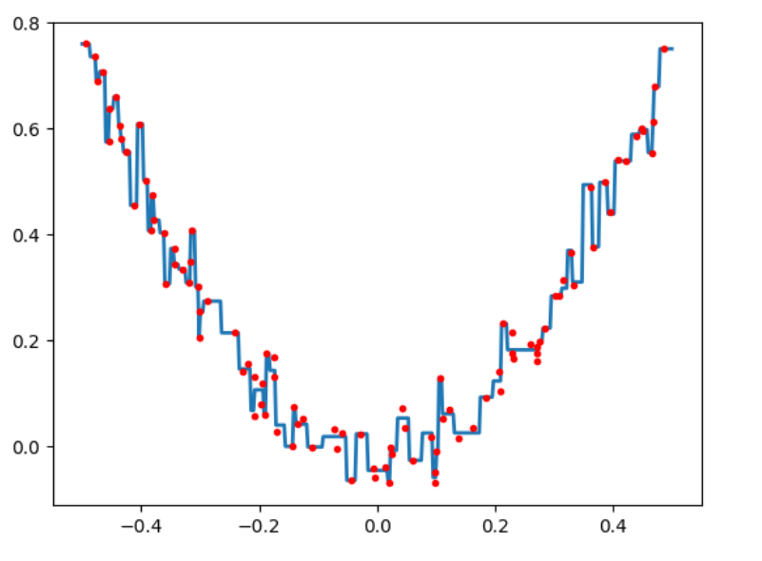
GREADIENT BOOSTING FOR REGRESSION
1
SCIKIT LIBRARY ACCURACY
R2 SCORE : 0.8121
MEAN ABSOLUTE ERROR : 0.33
ROOT MEAN SQUARED ERROR : 0.50
CUSTOM IMPLEMENTATION ACCURACY
R2 SCORE : 0.8016
MEAN ABSOLUTE ERROR : 0.34
ROOT MEAN SQUARED ERROR :0.51
2
11

Slide 12
Gradient Boosting for Classification
SCIKIT LIBRARY ACCURACY
ITERATION = 100
ACCURACY : 0.9561
1
CUSTOM IMPLEMENTATION ACCURACY
ITERATION = 100
ACCURACY : 0.9561
SCIKIT LIBRARY ACCURACY
ITERATION = 100
ACCURACY : 0.7403
CUSTOM IMPLEMENTATION ACCURACY
ITERATION = 1
ACCURACY : 0.7597
2
12

Slide 13
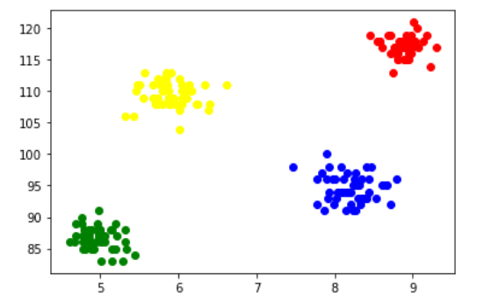
K-MEAN CLUSTERING
SCIKIT LIBRARY ACCURACY
CLUSTER = 2
ACCURACY : 0.8541
1
CUSTOM IMPLEMENTATION ACCURACY
CLUSTER = 2
ACCURACY : 0.8541
SCIKIT LIBRARY ACCURACY
CLUSTER = 3
ACCURACY : 0.893
CUSTOM IMPLEMENTATION ACCURACY
ITERATION = 3
ACCURACY : 0.666
2
13

Slide 14



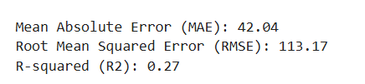
Why One Hot Encoding not Target Encoding
1
2
1
One Hot Encoding
Target Encoding
2
3
14

Slide 15
OPTIMIZATION DIFFERENCES
1
2
1
2
This section investigates the differences in optimization strategies between the custom implementation and Scikit-Learn. Key factors include how each library handles computational efficiency, numerical stability, and convergence speed. The custom library may adopt different techniques such as adaptive learning rates or mini-batch training, providing insights into their advantages and disadvantages compared to Scikit-Learn's optimizations. This will help illustrate the practical implications of choice in machine learning libraries.
3
13
15

Slide 16
CONCLUSIONS
1
2
In conclusion, the comparative study of a custom machine learning library against Scikit-Learn provides valuable insights into the implementation of fundamental regression algorithms. The exploration of topics such as optimization, regularization, and performance metrics reveals the practical trade-offs between creating custom solutions and utilizing established libraries. This study emphasizes the importance of understanding both the theoretical and pctical aspects of machine learning, enhancing real-world application capabilities.
16

Slide 17
Thank you!
1
2
3
1
2
Do you have any questions?
3
4
Please keep this slide for attribution
https://github.com/bhushanzade02
https://github.com/VaishnavMankar
5
17

